Slide 1
Capstone Project – The Battle of the Neighborhoods
Applied Data Science by IBM/Coursera
By Edward

Slide 2
Background
Optimal neighborhoods for new comers
London is the capital of UK, which attracts immigration from both domestic and international.
In 2018/19, there were more than 340 thousands of immigration moving into London.
New immigration family always find themselves struggling in finding the best spot for their family.

Slide 3
Relocation Problem
Solve for the optimal location for expats or immigrants interested in moving into London, UK.
Basic assumptions – education is the most critical for home location. Neighborhoods with sufficient education institutes for children will be ranked by its proximity to the city center as it will be more convenient for the parents to commute to work.
A data science model will be built to specify few most suitable neighbourhoods based on this criteria. Advantages of each area will then be clearly expressed so that best possible final location can be chosen by the new family.

Slide 4
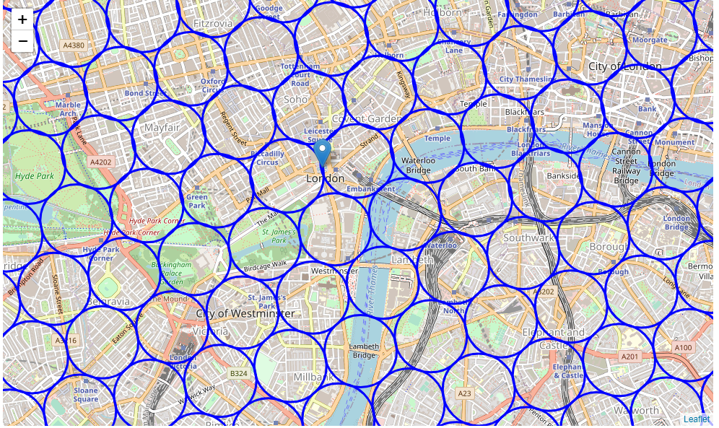
Data
Based on definition of our problem, factors that will influence our decision are:
number of schools in the neighborhood (any type of schools)
number of schools for young kids in the neighborhood
distance of neighborhood from city center
coordinate of London center will use Trafalgar Square
364 candidate neighborhood centers generated for our analysis

Slide 5
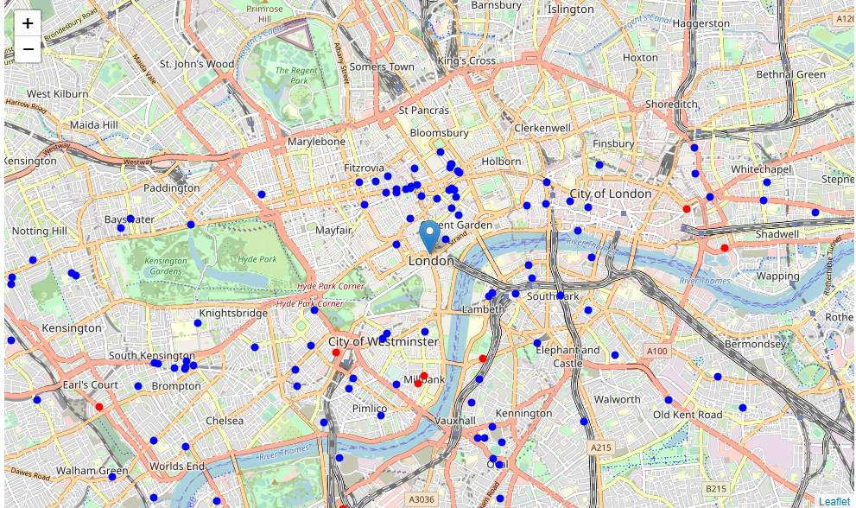
Foursquare
Total number of schools: 122
Total number of Children schools: 25
Percentage of Children schools: 20.49%
Average number of schools in neighborhood: 7.1

Slide 6
Methodology
Location and type (category) of every school within 6km from London city center
Calculation and exploration of density of schools across different areas of London using heatmaps to identify a few promising areas
Focus on most promising areas and within those create clusters of locations that meet some basic requirements
Present map by creating clusters (using k-means clustering) of those locations to identify neighborhoods for optimal venue location by stakeholders.

Slide 7
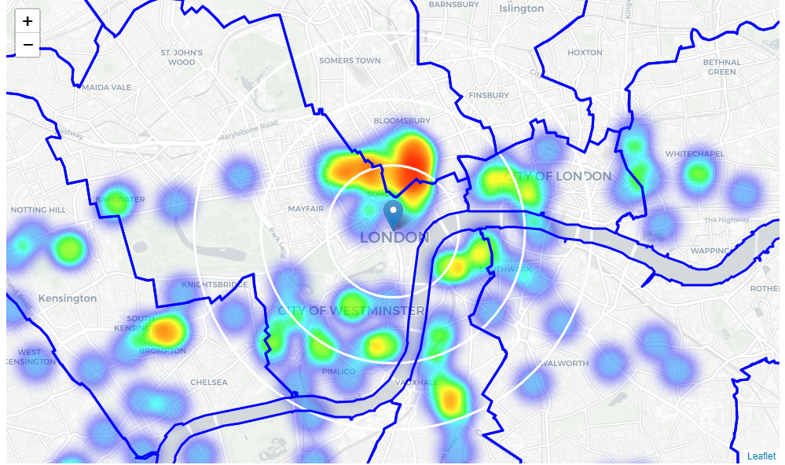
Analysis
Heatmap / density of schools with borders of London boroughs

Slide 8
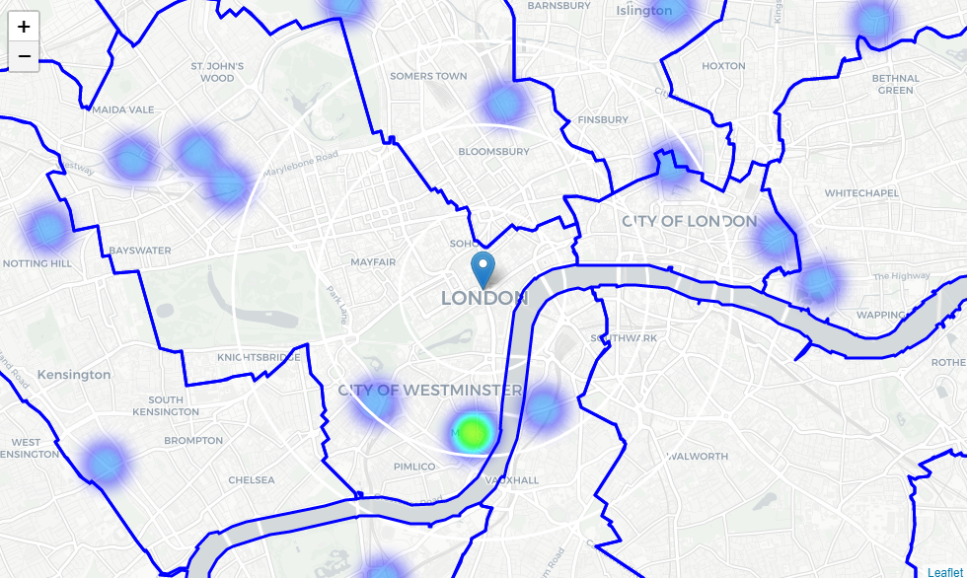
Analysis
Heatmap / density of Children Schools with borders of London boroughs

Slide 9
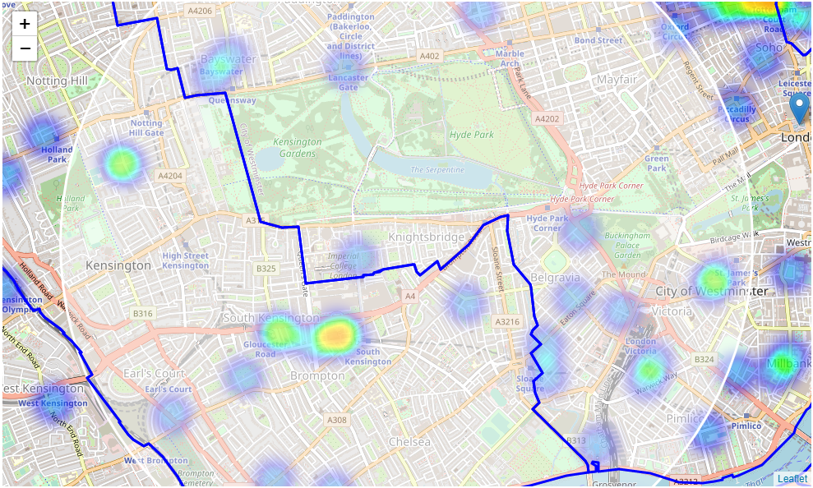
Notting Hill and Victoria
This map has covered one of the schools cluster in the west London and it's good for family as Hyde Park is right at the centre of this area.

Slide 10
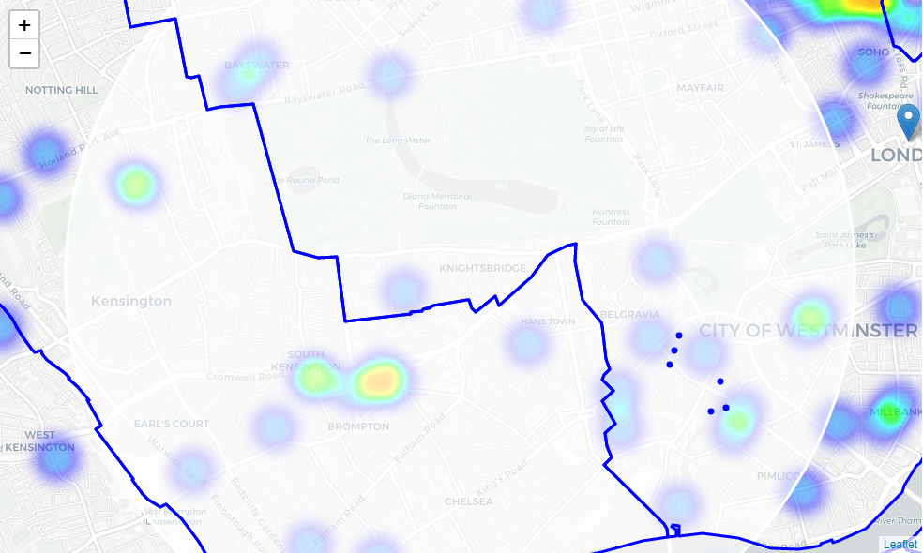
Focus area by filters
locations with >2 schools in radius of 250m & 1 school for children in radius of 400m.
Locations with more than two schools nearby: 111
Locations with children school within 400m: 127
Locations with both conditions met: 6

Slide 11
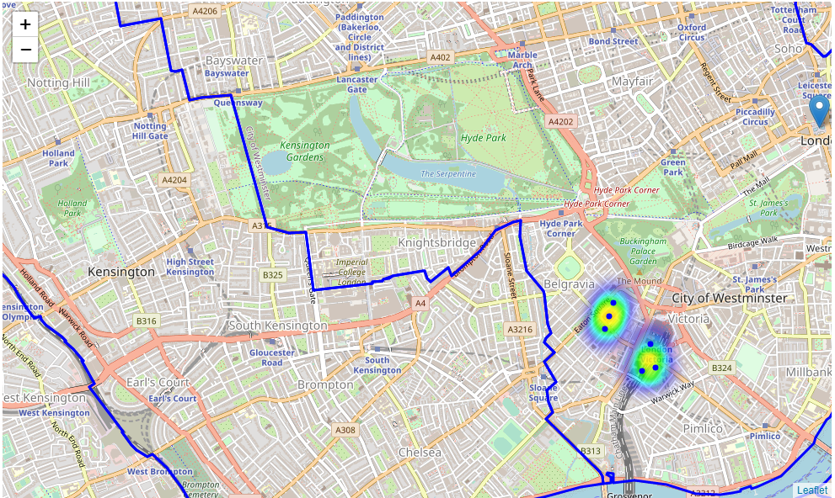
Focus area by filters
Heatmap View

Slide 12
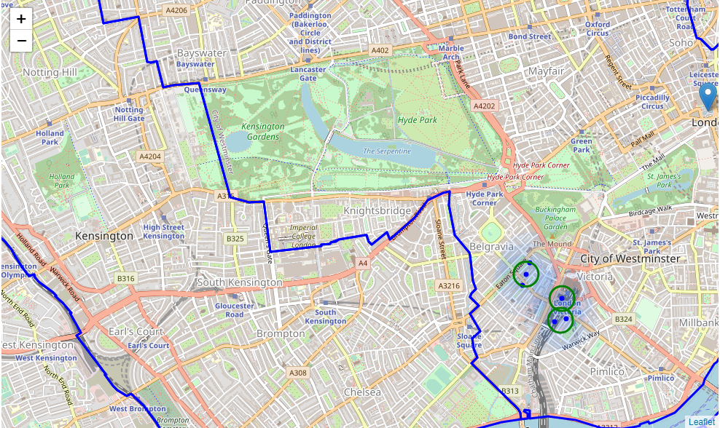
Focus area by filters
Clusters

Slide 13
Results
Primary focus –location data for schools that serve the younger kids, e.g. nusery, kindergarten, junior and primary schools.
Located several areas with cluster of schools in central london near Holborn, Notting Hill, Victoria, Waterloo and Whitechapel.
Notting hill and Victoria are the areas closest to city centre with decent number of schools for children available.
with more than two schools in radius of 250m and those with schools for childern closer than 400m were included.
Formed 3 clusters (potential best solution) within the area of Victoria based on our assumptions.
Might not be the optimal locations but a good starting / benchmark

Slide 14
Conclusion
Targeting to expats or immigrants interested in moving into London, UK.
The neighborhoods with sufficient education institutes for children and then ranked by its proximity to the city center .
By using location data from Foursquare and building our data science model to analyse the data.
Narrowed down to 2 neighborhoods, i.e. Notting Hill and Victoria
Suggested 3 clusters which are closer to the city centre and with sufficient schools available for those new families moving into London.

